Slide 1
Kazakshtan Story
Relationship between connectivity speed and the population and wealth index indicators for urban and rural regions in Kazakshtan.

Slide 2
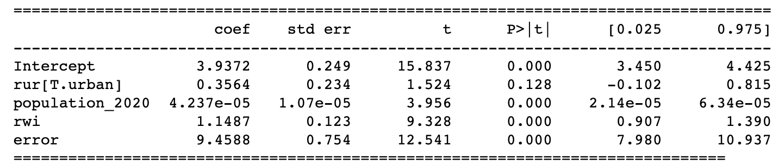
Connectivity speed ~ population + wealth index + Urban/rural region

Slide 3
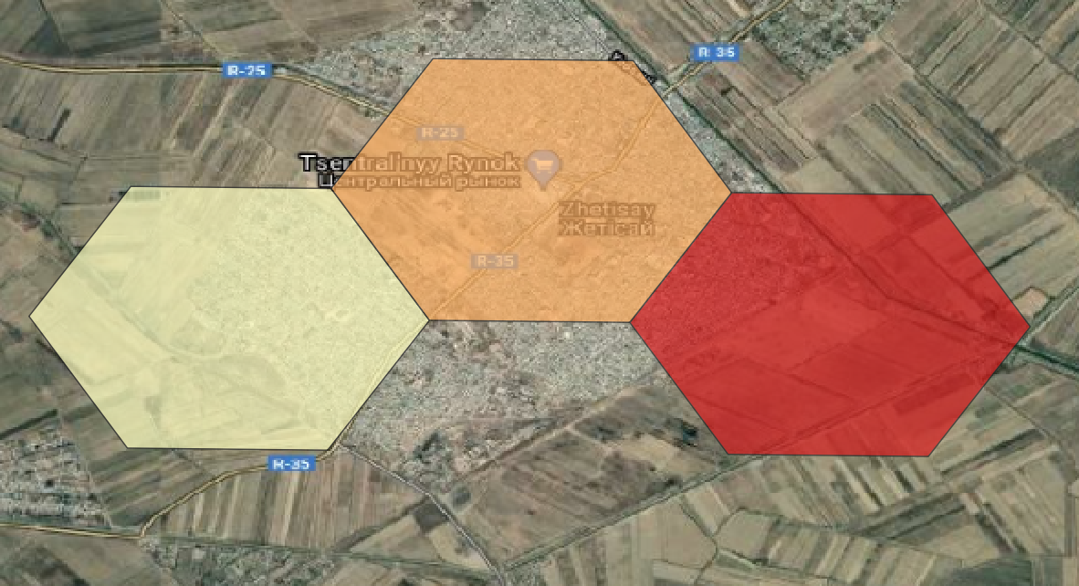
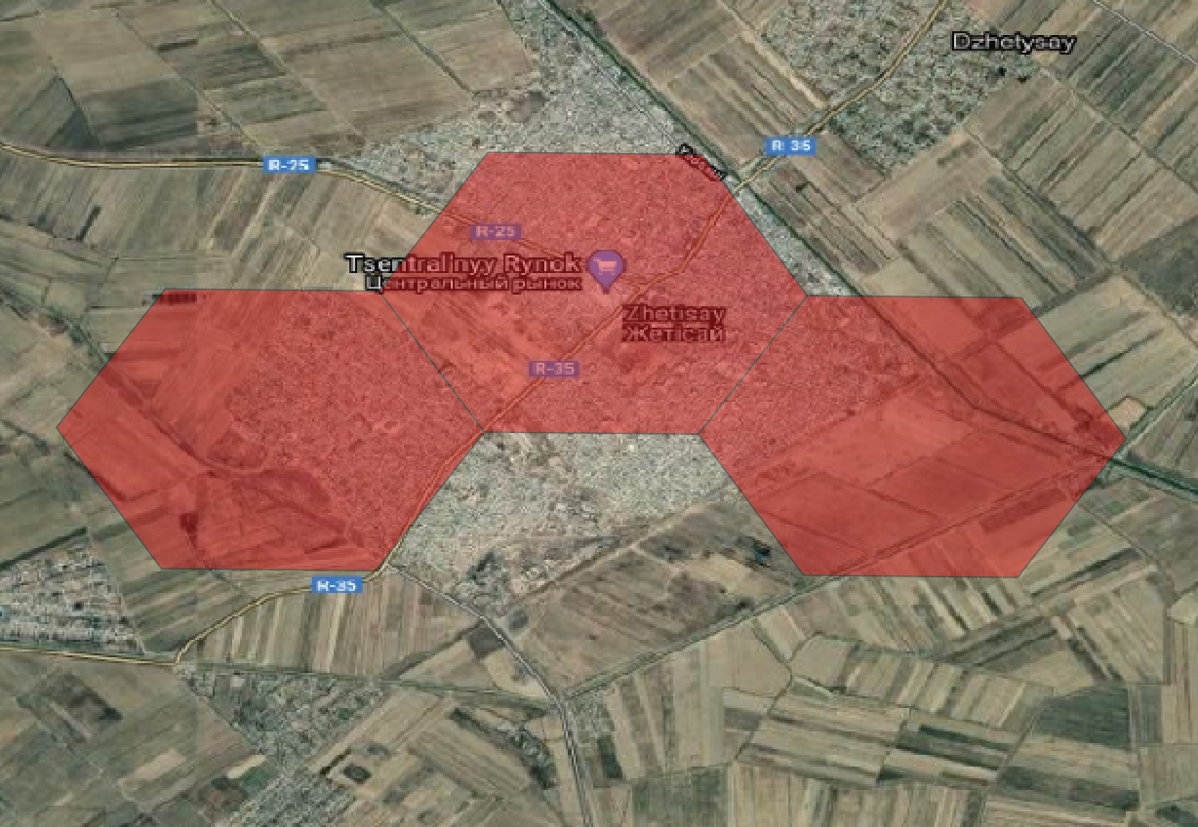
Urban region in Maktaaralskiy (South Kazakshtan): Lower connectivity in schools in lower wealth regions
Connectivity Speed
Wealth Index

Slide 4
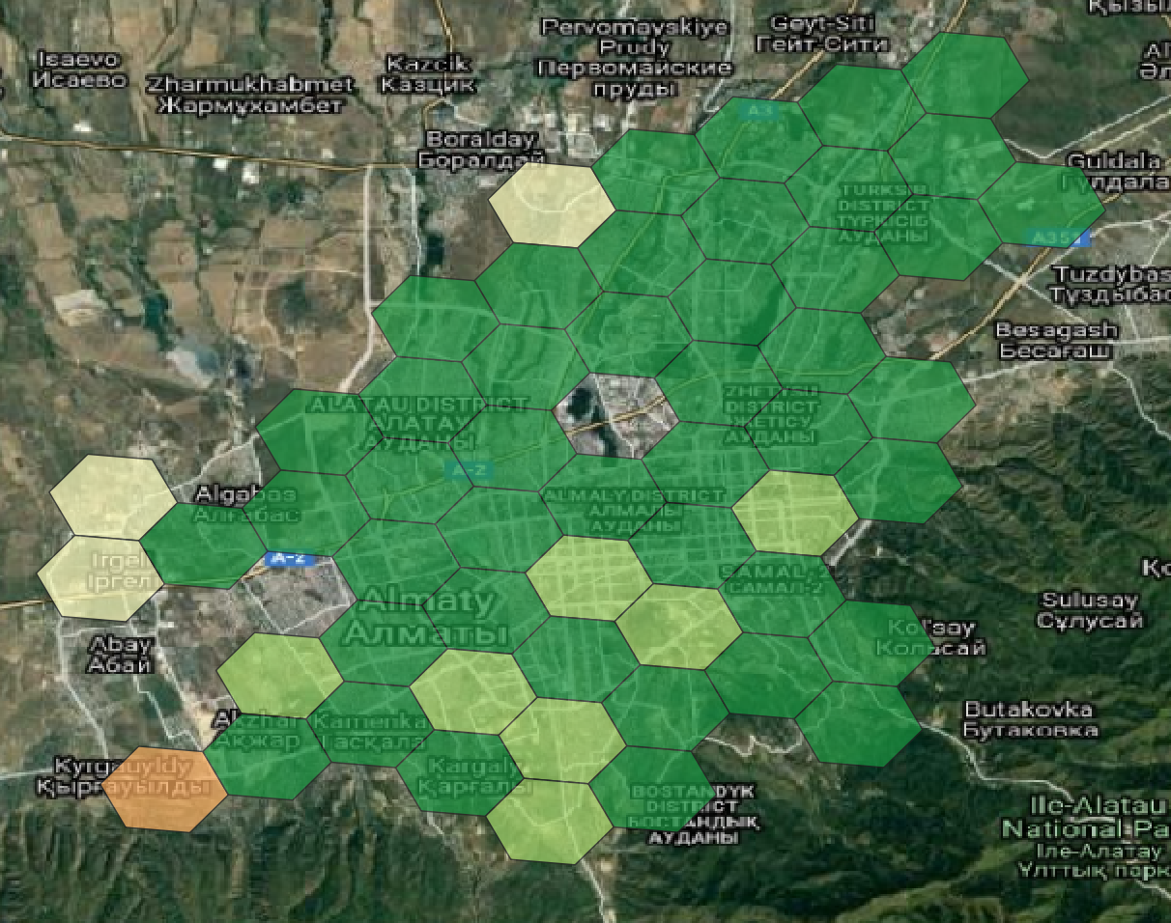
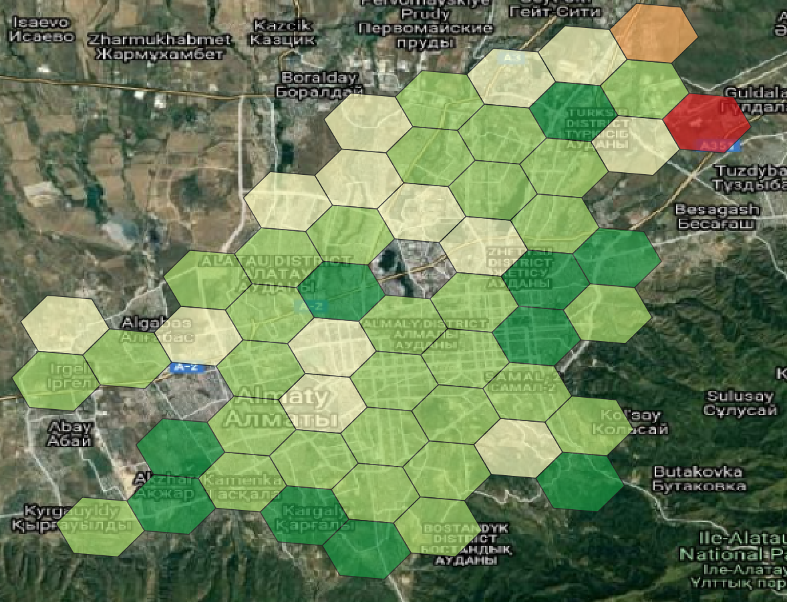
Urban region of Almaty (Alma-Ata): Higher connectivity in schools in higher wealth regions
Connectivity Speed
Wealth Index

Slide 5
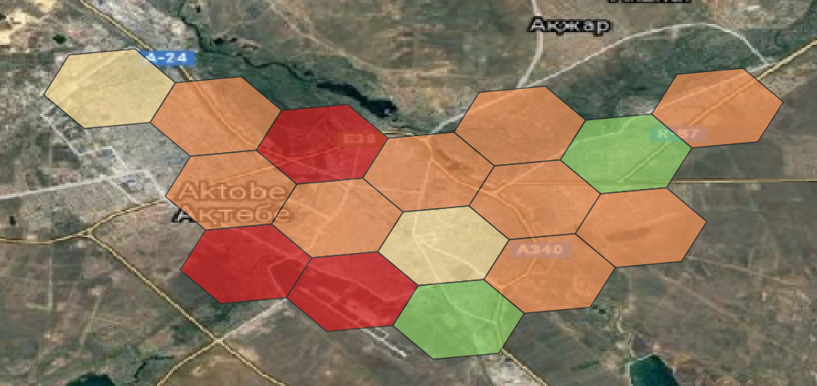
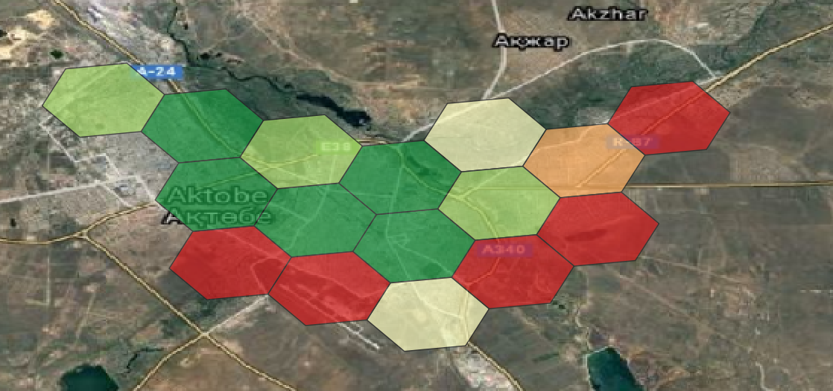
Urban town of Aqtobe: Low connectivity in schools inspite of high wealth regions - Could be a low hanging regions for businesses to provide connectivity - Could be unidentified business or political conflicts (Importance of having granular data – helps identify such uncoventional regions)
Connectivity Speed
Wealth Index

Slide 6
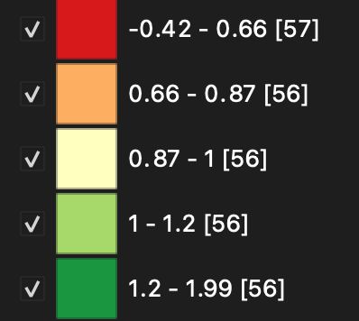
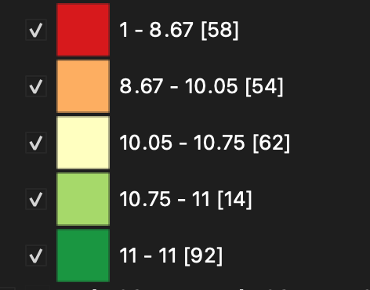
Legends (Quantile)
Connectivity Speed
Wealth Index

